Slide 1
Multiple Object Tracking Using Particle Filters
Paper : Robust Tracking-by-Detection using a Detector Confidence Particle Filter
Authors: Michael D. Breitenstein, Fabian Reichlin, Bastian Leibe, Esther Koller-Meier, Luc Van Gool
Conference: 2009 IEEE 12th International Conference on Computer Vision (ICCV)
Notes:
hello everybody, the topic of my presentation is MOT using particle filters, my project is based on the paper Robust tracking by detection using a detector confidence particle filter by Breitenstein, their paper was originally presented in the ICCV conference in 2009

Slide 2
Multiple Object Tracking Problem Definition
Given an image sequence that contains multiple objects, find the state (position, size) of each object across the frames, and link the states of each object into trajectories.
It is an ill-posed and inverse computer vision problem
Notes:
First let’s define the multiple object tracking problem
given
The ill-poseness comes from occlusions, for example a person walk behind a wall, there is no unique solution of the object’s state, because the information is lost behind the wall,

Slide 3
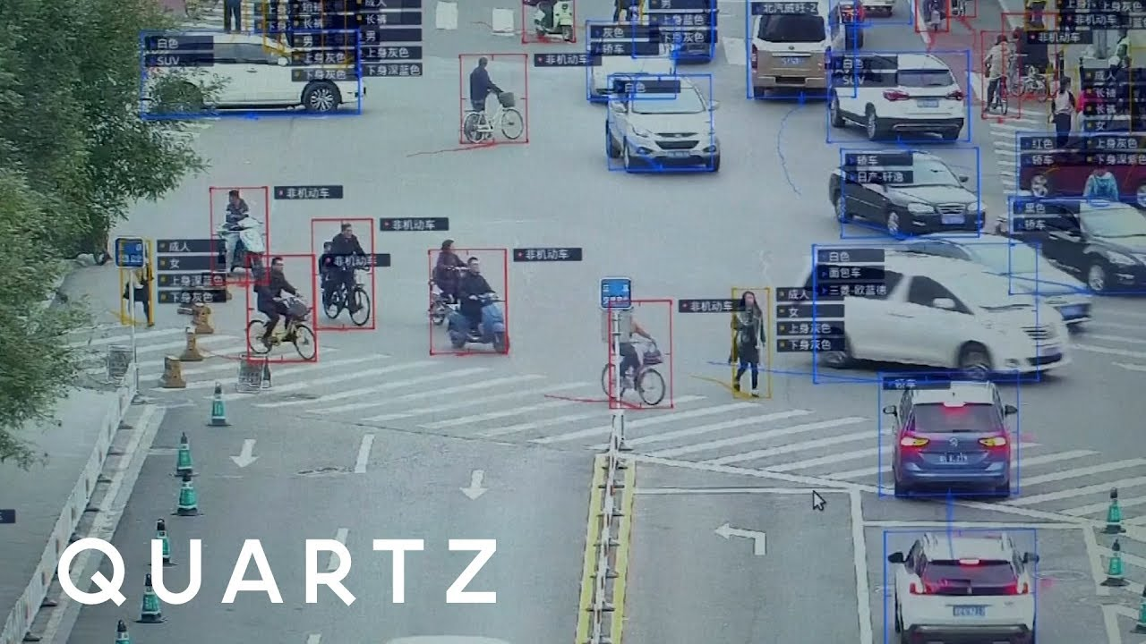
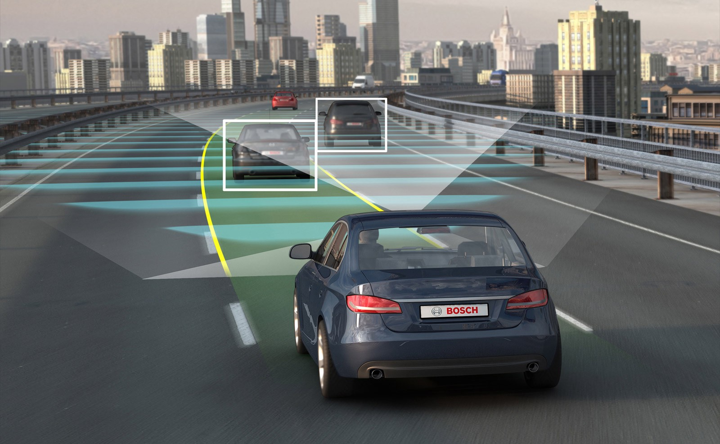
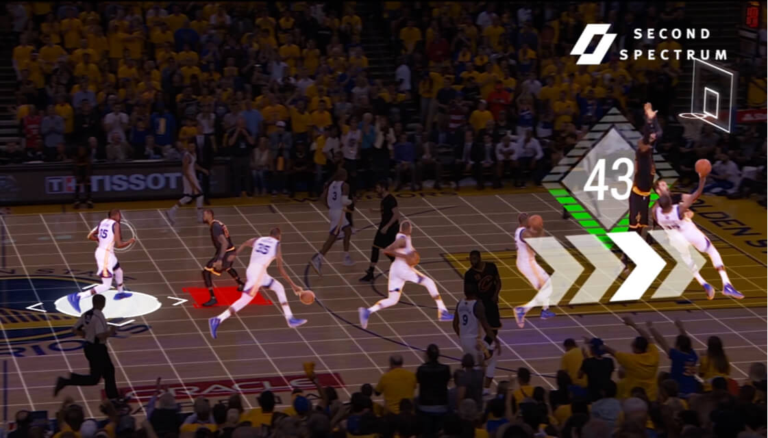
Applications
Sport Analytics
Visual surveillance
Autonomous driving
And more
Images courtesy of Second Spectrum, Quartz and auto.economictimes.com
Notes:
Obiviously object tracking is useful, Here are a few real world applications of object tracking. First sport analytics, tracking player’s location in the gameplay video can help us understand the game better. Visual surveillance, it is where the government around the world spend million’s of dollars, or at least in my home country, and autonomous driving viechale

Slide 4
Other Multiple Object tracking Models
Recurrent Net
Tracking The Untrackable: Learning to Track Multiple Cues with Long-Term Dependencies by Sadeghian et. al. ICCV 2017
Reinforcement Learning
Learning to Track: Online Multi-Object Tracking by Decision Making by Xiang et. al. ICCV 2015
Graphical Method
Multiple people tracking by lifted multicut and person re-identification by Tang et. al. CVPR 2017
Notes:
There are also plenty of other methods that are being used to do multiple object trackin, for example recurrent net, reinforcement learning and graphical method, you can read the paper I suggested on your own if you are interested

Slide 5
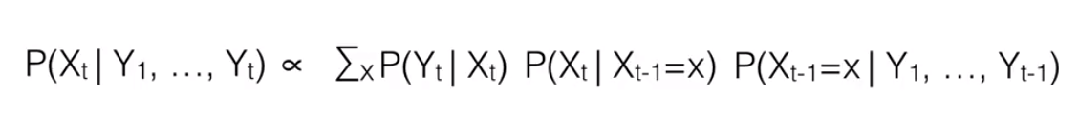
What is a Particle Filter
Goal: to estimate the Posterior distributions of Markov Process, given some noisy observations
Approach:
Use a set of particles to represent the posterior distribution
Propagate particles using the transition model predict the next state.
Reweight particles according to the observation likelihood given an observation
Resample particles according to the likelihood weights, and we get the new set of particles to represent the posterior for next state
Before observation
Likelihood weight
Transition Model
Previous posterior estimation
Notes:
So what is a particle filter？
The goal is to estimate the Posterior distributions of Markov Process, given some noisy observations, in our case, for MOT the noise observations are the object detections, and the posterior distribution is a identity’s state being a certain size and location given observations
The particle filter can be decomposed into four steps,
Use a set of particles to represent the posterior distribution
Propagate particles using the transition model
In this project we assume a constant motion model, and we assume the object is moving from the side it appears to the opposite side initially
Given an observation of next state, each particle has a likelihood weight
Resample particles according to the likelihood weights, and we get the new set of particles to represent the posterior for next state
Those steps will be discussed in detail in later slides
As you can see in the equation below, the posterior distribution can be approximated by the sum of the likelihood weight of each particles, which is the probability of the observation given the particle’s state times the product of the motion model which is the probability of end up at certain state given previous state and the posterior estimation of previous state

Slide 6
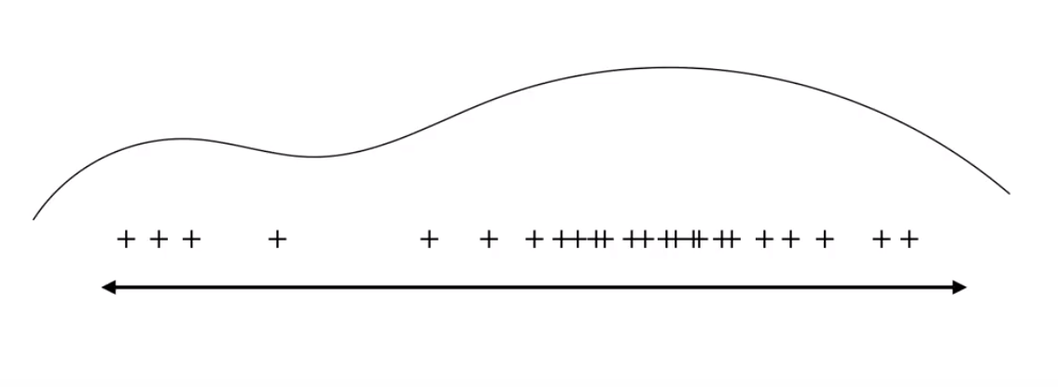
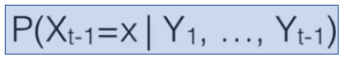
Particle Filtering
Images taken from Bert Huang’s Youtube Lecture https://www.youtube.com/watch?v=lzN18y_z6HQ&t=475s
Notes:
From here you can see the density of the samples represents the density of the posterior,
Lets assume this is an estimation of last state given observations until last state

Slide 7
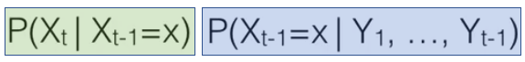
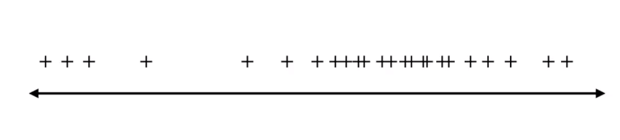
Transition
According to the transition probability model
Image taken from Bert Huang’s Youtube Lecture https://www.youtube.com/watch?v=lzN18y_z6HQ&t=475s
Notes:
And then we apply an motion model to the previous states estimated by previous observations, as mentioned before the motion model is the probability of an object endup at a certain state given previous state

Slide 8
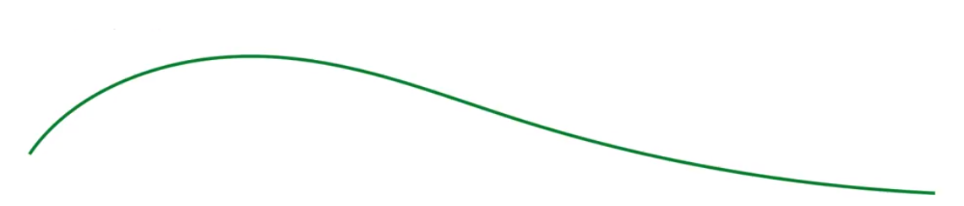
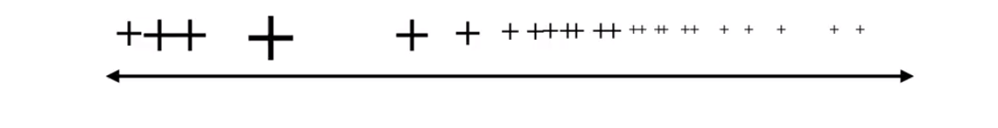
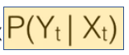
Reweight
According to the new observation
Images taken from Bert Huang’s Youtube Lecture https://www.youtube.com/watch?v=lzN18y_z6HQ&t=475s
Notes:
At this step we received a new observation perhaps a detection, and we can then calculate the likelihood of each particle’s state estimation, and reward the particles that is doing a good job a bigger weight, and naturally the likelihood probability can serve as the particle weight

Slide 9
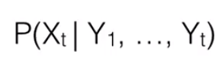
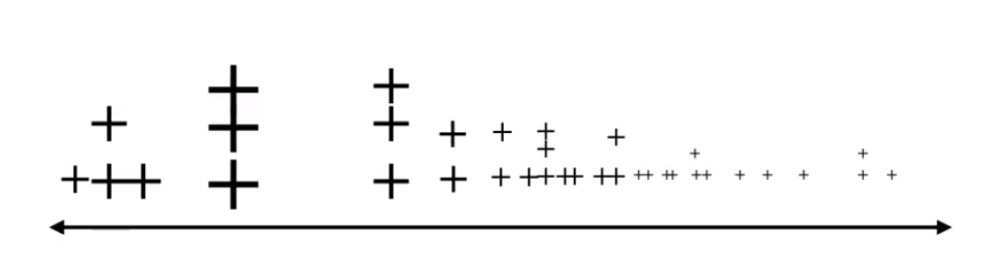
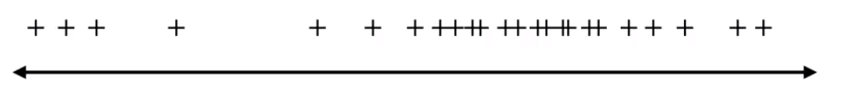
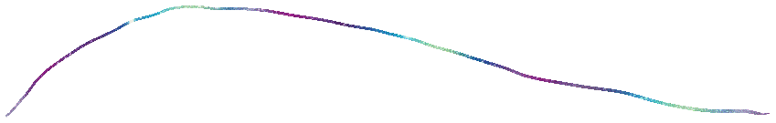
Resample
A new set of particle to represent the current state posterior
Image taken from Bert Huang’s Youtube Lecture https://www.youtube.com/watch?v=lzN18y_z6HQ&t=475s
Notes:
Then we resample according to the weight assigned at previous step, and we can then reset the weight to even weight since the density of the samples are a reflection of the weighted, then we can get a new posterior distribution function from those particles

Slide 10
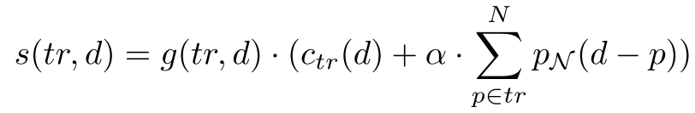
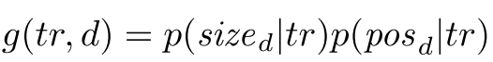
Particle Filter MOT – Data association
An individual particle filter is assigned to each track, where each particles contains the position and x, y directional speed
At each time step, assign detections to each track greedily according to the similarity score
where
Equations are taken from the paper Robust Tracking-by-Detection using a Detector Confidence Particle Filter by Breitenstein et. al.
Notes:
So here is the detail of how multiple object tracking is done using particle filters
First an individual particle filter is representing a individual track, the particle state is the position of the object and the x, y direction speed
At each frame, we run an object detector and then we assign the detections to tracks(particle filters) greedily, MAP!! , the similarity score of a track and detection is calculated as follow, the gataing function g is the probability of the size and position of the detection given the size and position of the track, we used zero mean gaussians to evaluate these. the stuff in the brackets compares the appearance of the tracker and the detection as well as the individual particles’ location with the detection’s location

Slide 11
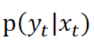
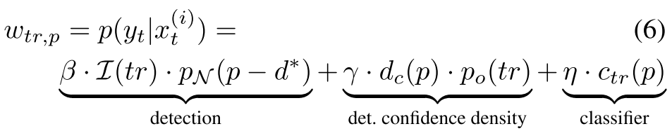
Particle Filter MOT – observation likelihood weight
For each particle filter (track) the newly assigned detection (bounding box) is the new observation
Reweight the particles according to the observation likelihood
calculated as follow:
Equations are taken from the paper Robust Tracking-by-Detection using a Detector Confidence Particle Filter by Breitenstein et. al.
Notes:
After the pfs received the detection at this frame, here is how the paper calculates the observation likelihood weights. For each particles, the weights is the detection position probability calculated by a zero mean gaussian function plus the detection confidence, plus the appearance comparence between the particle and the detection, this is carried out by a boosted binary classifier online for each object.

Slide 12
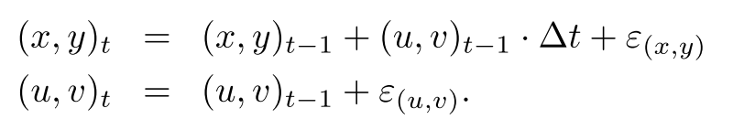
Particle Filter MOT – Motion Model
Propagate the particles to produce the estimation of the next state according to the motion model. Each particle’s state is a 4 element vector (x, y, u, v).
Where ɛ is zero mean gaussian noise
Get detections of next frame . . .
Equations are taken from the paper Robust Tracking-by-Detection using a Detector Confidence Particle Filter by Breitenstein et. al.
Notes:
Here is the motion model used for each particle, the current position is approximated by the previous location plus the previous speed plus the gaussian random noise
The current speed is modeled as the previous speed plus random gaussian noise.
The initial position is the first detection’s location, the initial speed direction is from the boundary the object appears to the opposite boundary

Slide 13
Implementation detail
Question: How to get the size of the object if particles do not carry size information?
The size of each track is the running average of the last 4 assigned detections.
Question: Any other modifications to the paper’s approach?
The detector, appearance comparison method, and likelihood weights calculation are different
Any assumptions?
Markovian assumption: the object state in current frame only depends on the information from last frame
A person can only walk into or out of the view from the side of the frame
Smooth movement, no sudden change of directions or speed
Notes:
Here are some implementation details, the size of the object is not recorded in the particles state, only the position and speed, this is the design choice of the paper, the size is calculated by the running average of the last four assigned detections.
In my implementation, I used a odifferent object detector and appearance model, and I changed the likelihood weights calculations a little bit
There are three assumptions being made in the paper, A person should only beable to walk into or out of the view from the side of the frame, not coming out from a building in the middle of the frame, that is also how tracks are initialization and termination are determined
We used a simple motion model so we assume the motion to be smooth

Slide 14
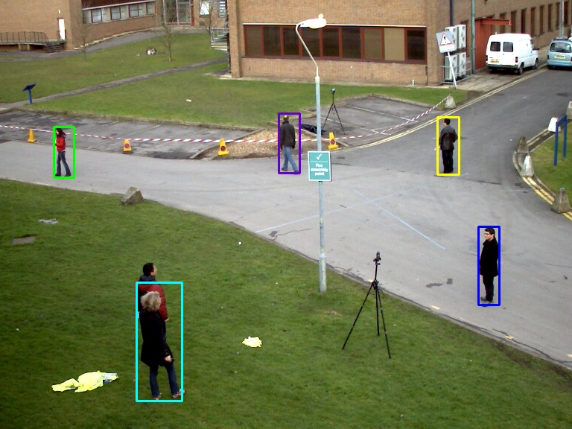
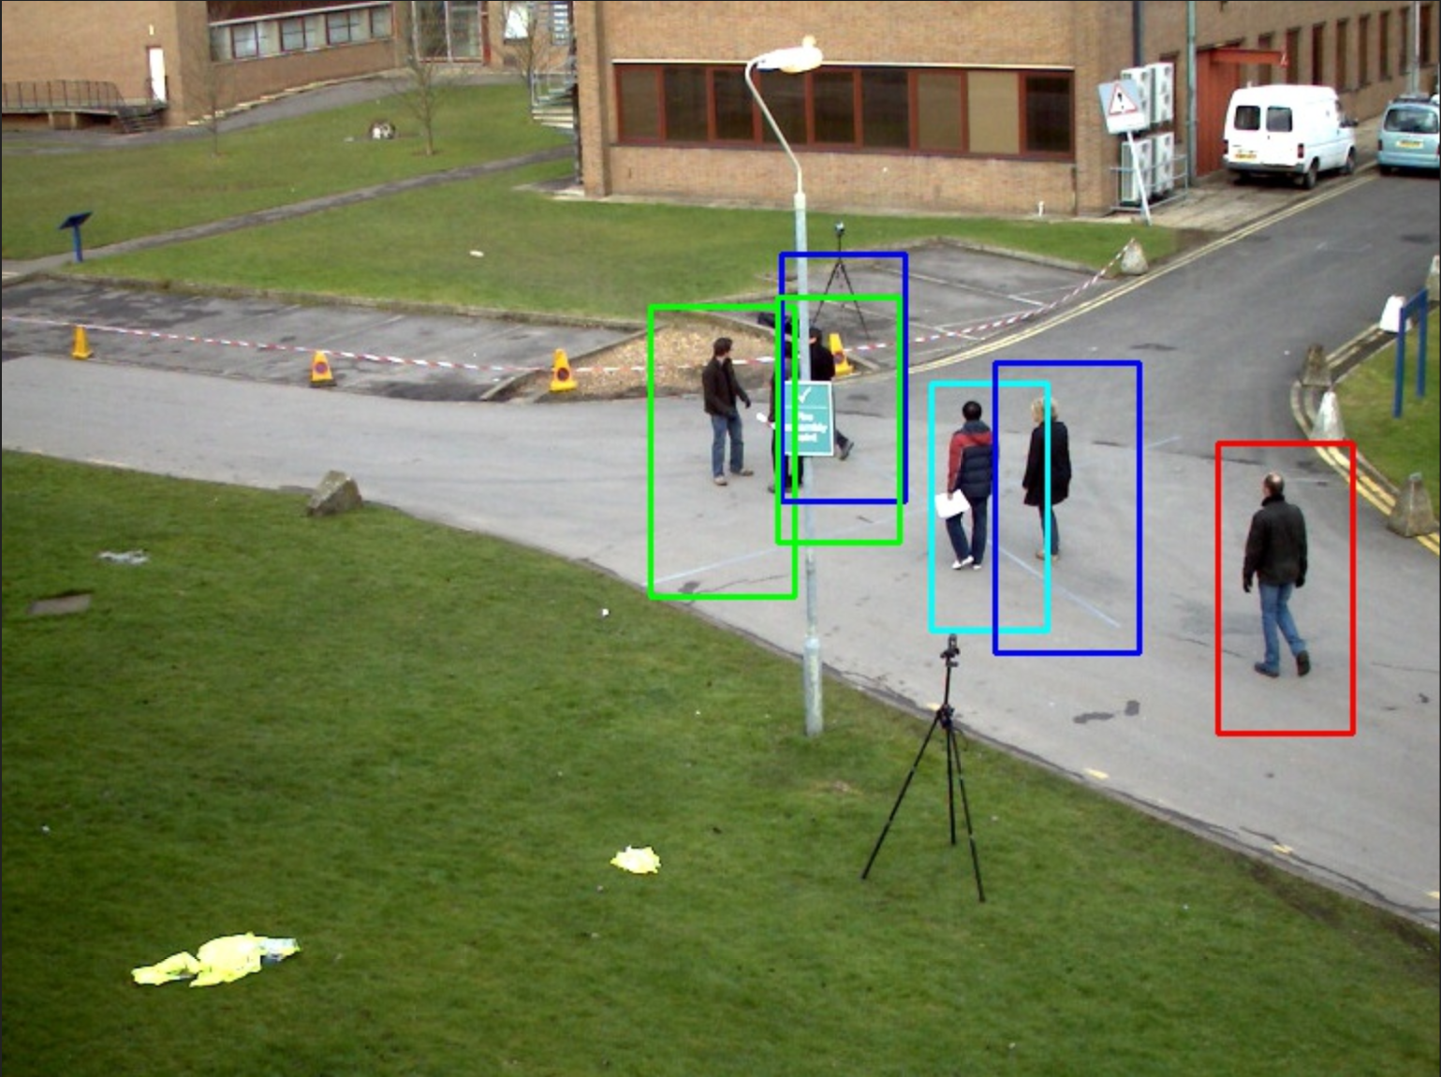
Detector Improvement
The paper used HOG based pedestrian detector
A COCO dataset pretrained deep learning based model from tensorflow called faster_rcnn_nas_lowproposals_coco is selected
Out-of-the-box detection result comparison
faster_rcnn_nas_lowproposals
HOG pedestrian detector from openCV
Notes:
In the project I compares both the faster rcnn based object detector and the HOG SVM detector model, both detectors are being applied to the frame out of the box, so there is no training and fine tuning involved.
As shown below the OpenCV pedestrian detector is not doing as good a job as the faster RCNN detector from tensorflow, which is pretrained on the COCO dataset. The COCO has 80 object classes, in this project I only extracted the detections that has the label person

Slide 15
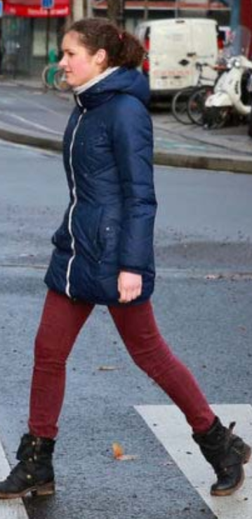
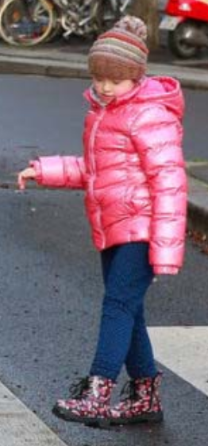
Appearance Model
The paper trained a boosted binary classifier online for each object.
Two part HSV histogram model inspired by Okuma’s paper is used in this project.
Compare HSV histogram
Compare HSV histogram
Okuma’s paper: A Boosted Particle Filter: Multitarget Detection and Tracking, ICCV 2005
Notes:
In the paper they used a boosted binary classifier, the goal of the classifier is to classifier whether a bounding box image has the same identity as this class or not. Since the appearance observation model is nither the focus of the original paper nor this project. I used a simple two part HSV histogram model instead. This model is inspired by Okuma’s paper on tracking, which it split the detection bounding box in the middle, and compare the upper part and lower part individually.

Slide 16
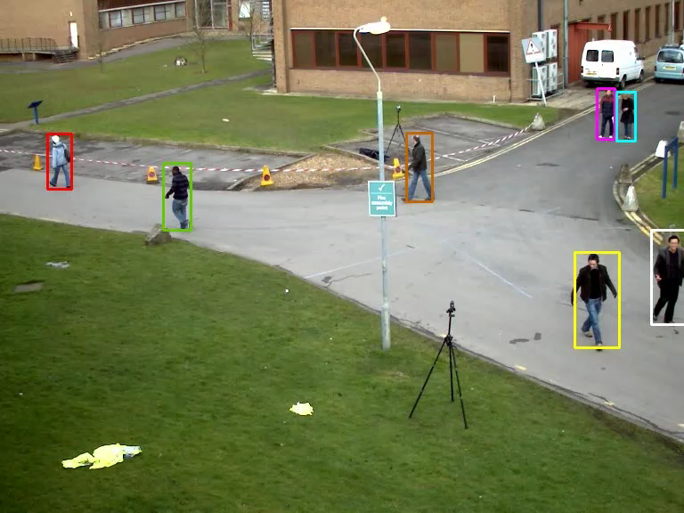
Tracking demo
PETS 2009 dataset S2 L1 clip
Notes:
The testing was done on the PETS 2009 dataset,

Slide 17
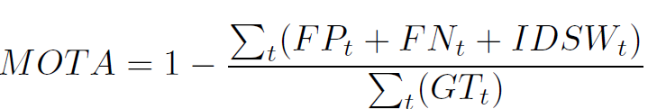
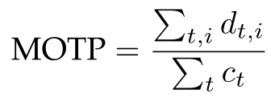
Evaluation Method
A combination of three sources of error to measure a tracker’s performance
The average IOU between ground truth and tracking result to measure the quality of the correctly tracked objects
Equations are taken from the paper MOT16: A Benchmark for Multi-Object Tracking by Milan et. al.
Notes:
The Most widely used scoring matrix, it does not exist when the paper was published
most widely used metric to evaluate a tracker’s performance. The main reason for this is its expressiveness as it combines three sources of errors defined above:
MOTA
MOTP
, d denotes the intersection over union between the tracking output bounding box and the ground truth bounding box, and c is the number of correctly tracked objects

Slide 18
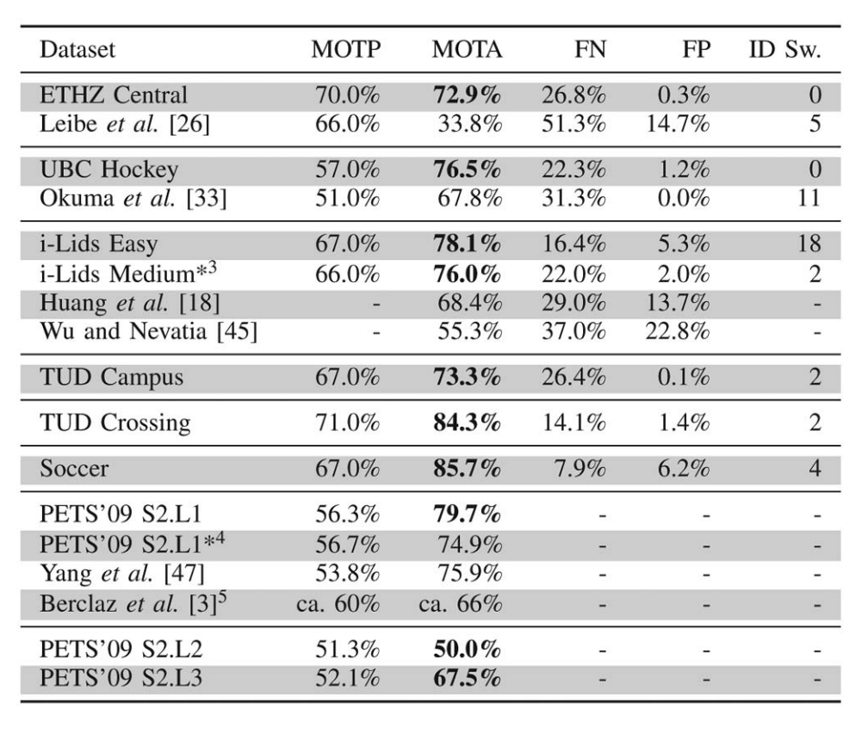
Result comparison
Tracking result from a later paper by the same authors using the same tracking model
Tracking result of this project
CLIP | MOTP | MOTA | Precision | FN | FP | IDSW
PETS 2009 S2L1 | 76.3% | 82.4% | 93.7% | 11.5% | 5.89% | 36
*The table on the right is taken from Online Multiperson Tracking-by-Detection from a Single, Uncalibrated Camera by Breitenstein et. al.
Notes:
MOTP out performs their original work by a large margin probably because the better detector that is being used. And My MOTA score is also better than the original work , this could also because there is less errors in my detector which makes the observation the pf receive less noisy, and the calculation of the likelihood calculation more accruate

Slide 19
Discussion
Disadvantages
Does not incorporate all past state information
Assumptions about new detection validation might not generalize well
Advantages
Simplicity, easy to implement
The particle filter approach scales well, everything is parallelable
It can incorporate any observation model we can design into the likelihood weights
Online method
Notes:
The main disadvantage of this model is the markovian assumption, we assumed the current state only depends on the last state, but in real world, all past states can have a impact on the current state, for example we can determine the acceleration and more accurate velocity if we can look further back.
The second disadvantage is the assumption made in the motion model,
There are also some advantages, first it is an online method, which means the model only relies on the past information, this properity enables it to be used in many applications
‘

Slide 20
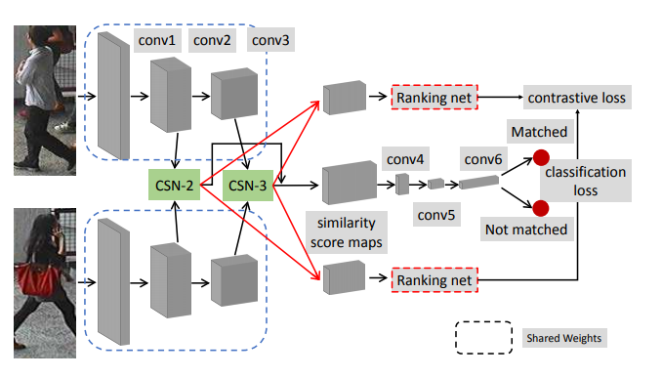
Potential Improvement
Use a better motion model instead of assuming constant speed
Use better observation models:
Use a deep learning based detector dedicated to pedestrian detection
Use a deep learning based Re-ID model as the appearance model
For example: Efficient and Deep Person Re-identification Using Multi-level Similarity by Guo and Cheung, CVPR 2018
Image taken from Efficient and Deep Person Re-identification Using Multi-level Similarity by Guo and Cheung

Slide 21
Questions?

